Slide 1


Noida Institute of Engineering and Technology, Greater Noida
Project Identification & Selection
Unit: II
Project Management
AOE0761
Harshit Thakur
Assistant Professor
CSE
BTECH 4TH YEAR VII Semester

Slide 2
Index/Content
S. No. | Index
1. | Name of Subject with code, Course and Subject Teacher
2. | Brief Introduction of Faculty member with Photograph
3. | Evaluation Scheme
4. | Syllabus
5. | Branch wise Application
6. | Course Objective(s)
7. | Course Outcome(s)
8. | Program Outcomes (POs)
9. | COs and POs Mapping

Slide 3
Index/Content
S. No. | Index
10. | Program Specific Outcomes (PSOs)
11. | Cos and PSOs Mapping
12. | Program Educational Objectives (PEOs)
13. | Result Analysis
14. | End Semester Question paper Templates
15. | Prequisite/Recap
16. | Brief Indtroduction about the Subject with Videos
17. | Unit Contents
18. | Unit Objectives
19. | Topic Objectives/Topic Outcome

Slide 4
Index/Content
S. No. | Index
20. | Lecture related to topic
21. | Daily Quiz
22. | Weekly Assignment
23. | Topic Links
24. | MCQs
25. | Glossary Questions
26. | Old question papers
27. | Expected Questions
28. | Recap of unit

Slide 5
Brief Introduction of the Faculty Member
Faculty Name: Harshit Thakur
Designation: Assistant Professor
Department: CSE
Email ID: harshit.thakur@niet.co.in
Qualification: M.Tech, B.Tech
Specialisation: CSE
Research Area: Cloud Computing
Total Experience: 1 Year
Notes:
https://www.studocu.com/in/document/apj-abdul-kalam-technological-university/entrepreneurship-development/entrepreneurship-development-chapter-2-aktu-quantum-series/16491529

Slide 6
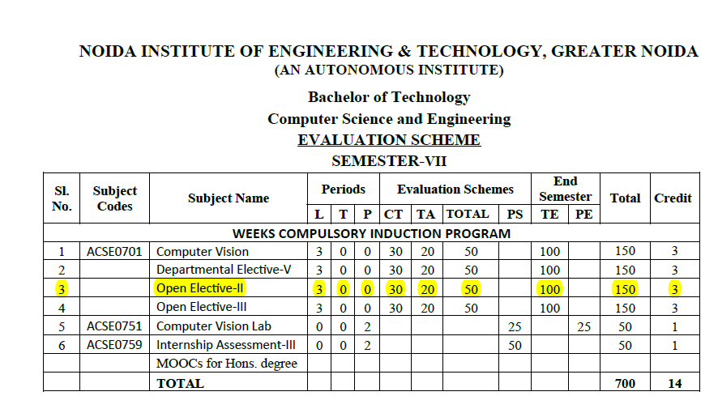
Evaluation Scheme

Slide 7
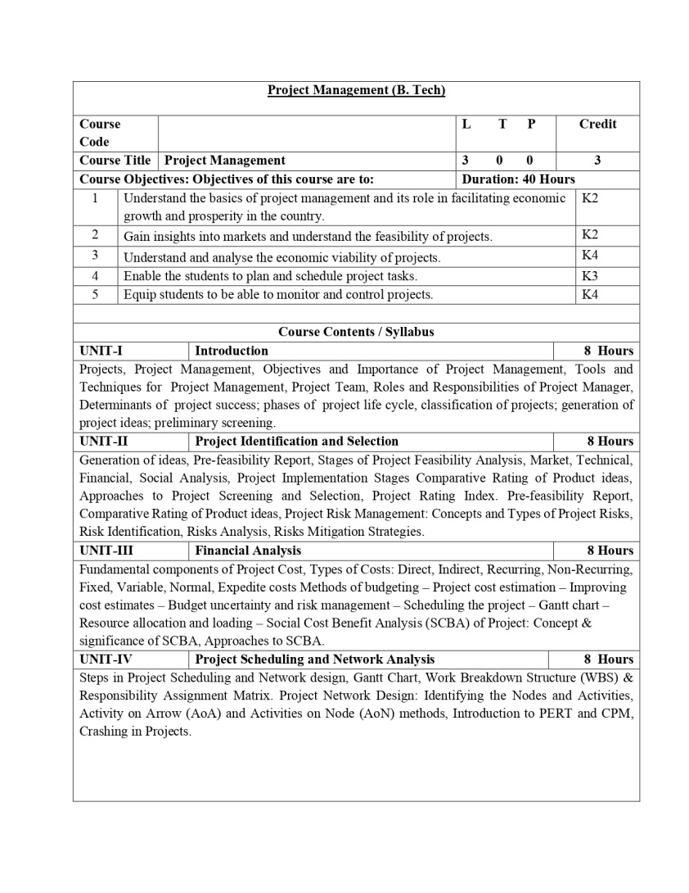
Syllabus

Slide 8
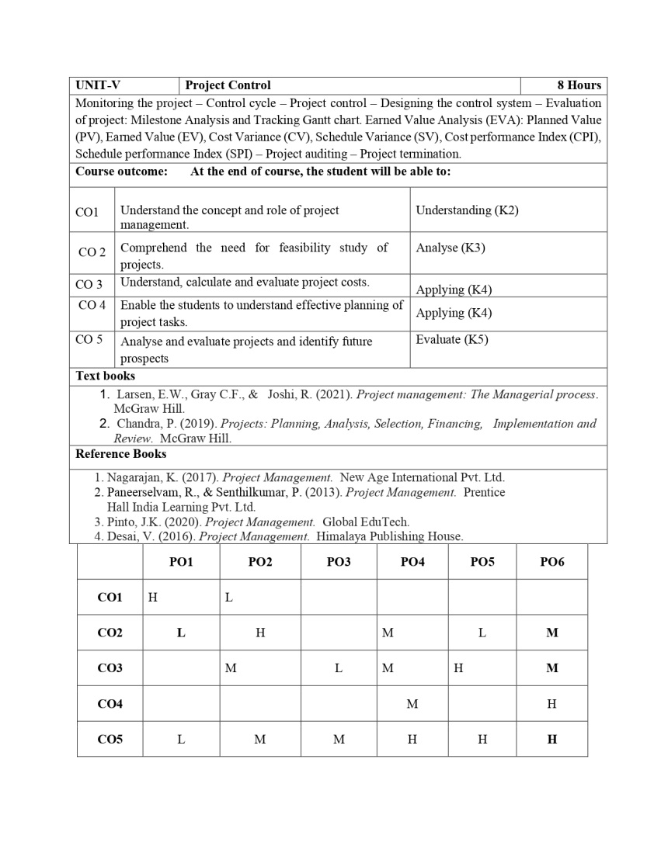
Syllabus

Slide 9
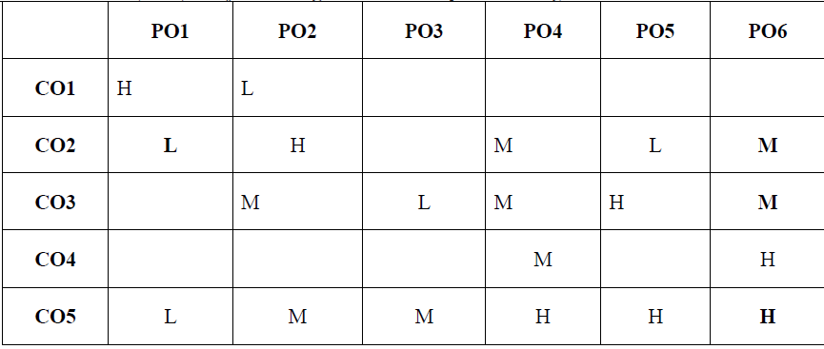
CO-PO Mapping
SHRUTI SHARMA Unit 1

Slide 10
Prerequisites and Topic wise Recap
Prerequisites for this session are:
General understanding of project management.
General understanding of tools & techniques of project management.
Recap:
Introduction of project
Project management process
Project team
Scope of project management

Slide 11
Topic & CO Mapping
S No | Topic | CO | Level
1 | Identification, Generation of ideas | CO 2 | 1
2 | Approaches to Project Screening and Selection | CO 2 | 1
3 | Project Rating Index | CO 3 | 1
4 | Market & Demand Analysis Techniques | CO 2 | 2
5 | Concepts and Types of Project Risks, | CO 2 | 1
6 | Risk Identification | CO 2 | 1
7 | Risks Analysis | CO 2 | 2
8 | Risks Mitigation Strategies | CO 2 | 1

Slide 12
Content
Project Identification & Selection:
Identification, Generation of ideas,
Approaches to Project Screening and Selection,
Project Rating Index
Market & Demand Analysis Techniques:
Project Risk Management:
Concepts and Types of Project Risks,
Risk Identification,
Risks Analysis,
Risks Mitigation Strategies.

Slide 13
Objective of Unit
Objective of this unit are:
To understand that how projects are identified and selected.
To understand and conduct the market and demand analysis
To manage the project risks in relation to risk identification, risk analysis and their mitigation strategies

Slide 14
Course Outcome
CO1: Understand the concept and role of project management.
CO2: Comprehend the need for a feasibility study of projects.
CO3: Understand, calculate, and evaluate project costs.
CO4: Enable the students to understand effective planning of project tasks.
CO5: Analyse and evaluate projects and identify future prospects

Slide 15
Session/ Topic Objectives
To understand the Identification & Generation of ideas,
Topic | Course Outcome
Criteria of understanding the Identification & Generation of ideas, | CO2

Slide 16
Identification &Generation of ideas
Project Identification is often the outcome of TRIGGERING PROCESSES / EVENTS rather than an analytical exercise.
While the notion of identification is simple, it is difficult to develop methods or procedures for accomplishing it.
(Uniqueness in decision making, non routine decisions on top level)
Notes:
What you mean by project identification, in hindi, how to find out effective project (youtube link)
https://www.youtube.com/watch?v=gHisxz1BskA

Slide 17
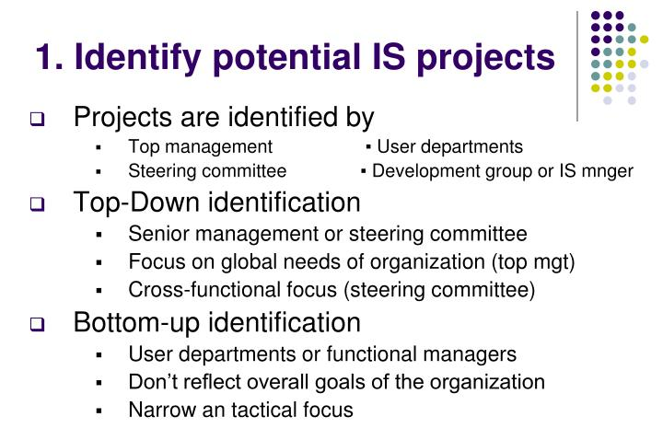
Project Identification

Slide 18
Project Identification
Requires:
Imagination
Sensitivity to Environmental Changes
Realistic assessment of what firm can do

Slide 19

Generating Project Ideas
Analyze the performance of existing industries
Examine inputs & outputs of various industries
Review imports & exports
Study plan outlay & Government guidelines
Investigate local materials & resources
Analyze economic & social trends.

Slide 20

Generating Project Ideas
Study new technological developments
Draw clues from consumption abroad
Explore the possibility of reviving sick units
Identify unfulfilled psychological needs
Attend trade fairs
Stimulate creativity for generating new ideas

Slide 21
Pre-feasibility Study
After the identification stage, the project ideas are subjected to a process of preliminary filtration through a pre-feasibility study. This involves the study of the project idea at a more elaborate level than that carried out at the opportunity study state.
This is an intermediate stage between an opportunity study and a full-fledged feasibility study primarily designed to probe relatively doubtful project ideas.
This stage is recommended to be followed when project formulation, or a detailed techno-economic feasibility study, which would enable the investor to arrive at a definite decision about the project, which is both costly and time-consuming.

Slide 22
Pre-feasibility report
As it is not practical to discuss all such aspects for various types of investment alternatives here, we will take a look at UNIDO'S outline of pre-feasibility study only for industrial projects, a modified version of which is given below.
Outline of a Pre-feasibility Study:
1. Executive Summary
2. Project background and history
3. Analysis of demanded supply:
Demand capacities and market
Sales forecast and marketing
Production program
Plant capacity
4. Analysis of inputs
5. Location and site

Slide 23
Pre-feasibility report
6. Engineering & technology
7. Organization: This gives,
an outline of one recommended organisation structure for production, sales, and administration; and
estimates of overhead costs (covering factory, administration and financial arrangements).
8. Manpower
9. Execution schedule & methodology
10. Financial & economic evaluation

Slide 24
Pre-feasibility report
This relates to the fundamental distinction between form and content. In other words, even if a feasibility report has systematically covered all the relevant aspects, it may still lead to an incorrect project decision if -
the project formulation suffers from incomplete or inadequate data; or
the underlying data or assumptions are unrealistic or incorrect or incorporate excessive safety margins; or
the report has been deliberately tailored to meet (or fail) acceptance criteria, for example by inflating (deflating) revenues and deflating (inflating) outlays; or
unknown or unpredictable factors intervene.

Slide 25
STAGES OF PROJECT FEASIBILITY ANALYSIS
Project feasibility analysis is a critical process to determine whether a proposed project is viable and worth pursuing. It involves a systematic assessment of various factors to evaluate the project's potential for success.
1. Preliminary Analysis
- Objective: Identify the project’s initial viability and potential obstacles.
- Activities:
- Outline the project idea.
- Assess the project's alignment with organizational goals.
- Conduct a preliminary market assessment.
- Evaluate potential challenges and constraints.
- Determine if further detailed analysis is warranted.
2. Market Feasibility
- Objective: Assess the demand for the project’s outputs.
- Activities:
- Conduct market research to understand target audience needs.
- Analyze market trends, size, and growth potential.
- Evaluate the competitive landscape.
- Identify potential market entry barriers and opportunities.
**

Slide 26
STAGES OF PROJECT FEASIBILITY ANALYSIS
3. Technical Feasibility
- Objective: Determine if the project can be technically executed.
- Activities:
- Assess the technical requirements of the project.
- Evaluate the availability of technology, resources, and expertise.
- Analyze potential technical challenges and risks.
- Determine the project’s technical soundness and resource needs.
4. Financial Feasibility
- Objective: Evaluate the project's financial viability.
- Activities:
- Estimate project costs, including capital, operating, and maintenance expenses.
- Forecast potential revenues and returns on investment (ROI).
- Perform cost-benefit analysis.
- Assess funding requirements and potential sources of financing.
- Analyze financial risks and sensitivities.
**

Slide 27
STAGES OF PROJECT FEASIBILITY ANALYSIS
5. Organizational Feasibility
- Objective: Assess the organizational capacity to execute the project.
- Activities:
- Evaluate the alignment with organizational culture and structure.
- Assess the availability and capability of human resources.
- Identify the impact on existing operations and resources.
- Determine the need for new skills or training.
6. Legal and Regulatory Feasibility
- Objective: Ensure compliance with legal and regulatory requirements.
- Activities:
- Identify relevant laws, regulations, and standards.
- Assess the impact of regulatory requirements on the project.
- Evaluate potential legal risks and issues.
- Plan for obtaining necessary permits and approvals.

Slide 28
STAGES OF PROJECT FEASIBILITY ANALYSIS
7. Environmental Feasibility
- Objective: Evaluate the project's environmental impact.
- Activities:
- Assess potential environmental effects and sustainability issues.
- Identify regulatory environmental requirements.
- Evaluate the need for environmental impact assessments.
- Plan for environmental mitigation measures.
8. Risk Assessment
- Objective: Identify and analyze potential project risks.
- Activities:
- Identify risks across all feasibility areas (technical, financial, market, organizational, legal, and environmental).
- Evaluate the likelihood and impact of each risk.
- Develop risk mitigation strategies.
- Prepare a risk management plan.

Slide 29
STAGES OF PROJECT FEASIBILITY ANALYSIS
9. Feasibility Report
- Objective: Document and present the findings of the feasibility analysis.
- Activities:
- Compile detailed findings from each feasibility stage.
- Provide recommendations based on the analysis.
- Present the feasibility report to stakeholders for review and decision-making.
- Include an executive summary, detailed analysis, conclusions, and appendices as necessary.
10. Decision-Making
- Objective: Decide whether to proceed with the project.
- Activities:
- Review the feasibility report and recommendations.
- Engage stakeholders in the decision-making process.
- Make a go/no-go decision based on the feasibility analysis.
- If proceeding, develop a project plan and outline next steps.

Slide 30
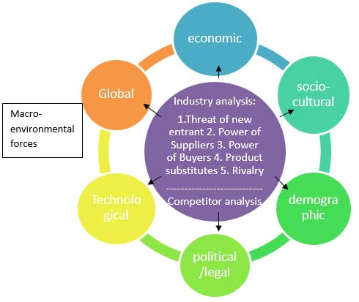
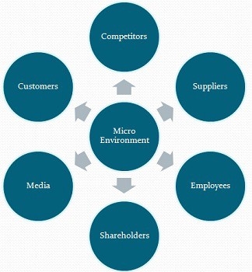
Adequacy of Market
Following factors have to be analyzed.

Slide 31
Technical Analysis
Objective: Assess whether the project is technically feasible and can be executed with the available resources and technology.
Key Components:
Technical Requirements:
Identify the specific technologies and methodologies required for the project.
Determine the technical specifications and standards.
Resource Availability:
Assess the availability of necessary resources, including materials, equipment, and skilled personnel.
Evaluate the current capacity and the need for additional resources.
Technical Expertise:
Determine whether the team has the necessary technical skills and expertise.
Identify any gaps in skills and plan for training or hiring as needed.
Technical Risks:
Identify potential technical challenges and risks.
Analyze the impact of these risks on the project timeline and success.
Develop mitigation strategies for identified risks.
Infrastructure:
Evaluate the existing infrastructure and its ability to support the project.
Plan for any required upgrades or changes to the infrastructure.
Output:
A detailed report outlining the technical feasibility, potential challenges, and mitigation strategies.

Slide 32
Financial Analysis
Objective: Evaluate the financial viability of the project by assessing costs, revenues, and financial risks.
Key Components:
Cost Estimation:
Estimate all project costs, including initial capital expenditures, operating expenses, and maintenance costs.
Include costs for resources, technology, personnel, and contingency funds.
Revenue Forecast:
Project potential revenues based on market analysis, pricing strategy, and demand forecasts.
Estimate the project's financial benefits and returns.
Funding Requirements:
Determine the total funding needed for the project.
Identify potential sources of funding, including internal funding, loans, grants, and investors.
Financial Metrics:
Calculate key financial metrics such as Net Present Value (NPV), Internal Rate of Return (IRR), payback period, and profitability index.
Perform a cost-benefit analysis to compare the costs and benefits of the project.
Financial Risks:
Identify financial risks such as cost overruns, revenue shortfalls, and funding delays.
Develop strategies to manage and mitigate these risks.
Output:
A comprehensive financial analysis report including cost estimates, revenue projections, financial metrics, and risk assessment.

Slide 33
Social Analysis
Objective: Assess the social impact of the project on stakeholders and the community.
Key Components:
Stakeholder Analysis:
Identify all stakeholders affected by the project, including community members, employees, customers, suppliers, and local authorities.
Analyze the interests, needs, and concerns of each stakeholder group.
Social Impact:
Evaluate the potential positive and negative social impacts of the project on the community and other stakeholders.
Consider factors such as job creation, community development, social inclusion, and potential disruptions.
Community Engagement:
Plan for engaging with the community and stakeholders to gather input and address concerns.
Develop strategies for communication, consultation, and participation.
Corporate Social Responsibility (CSR):
Align the project with the organization’s CSR goals and initiatives.
Assess how the project contributes to social and environmental sustainability.
Social Risks:
Identify potential social risks, such as community opposition, displacement, and social inequality.
Develop mitigation strategies to address these risks and ensure positive social outcomes.
Output:
A detailed social analysis report highlighting the project's social impacts, stakeholder engagement plans, and strategies for mitigating social risks.

Slide 34
Integrating the Analyses
After conducting technical, financial, and social analyses, the findings should be integrated into a comprehensive feasibility study report. This report should provide an overall assessment of the project's viability, considering technical feasibility, financial profitability, and social impact. It should include:
Executive Summary:
Summarize the key findings and recommendations from each analysis.
Detailed Sections:
Present the detailed technical, financial, and social analyses, including methodologies, findings, and supporting data.
Conclusion and Recommendations:
Provide a final assessment of the project's feasibility.
Offer recommendations on whether to proceed with the project, modify it, or abandon it.
Appendices:
Include any additional data, charts, and documents that support the analyses.

Slide 35
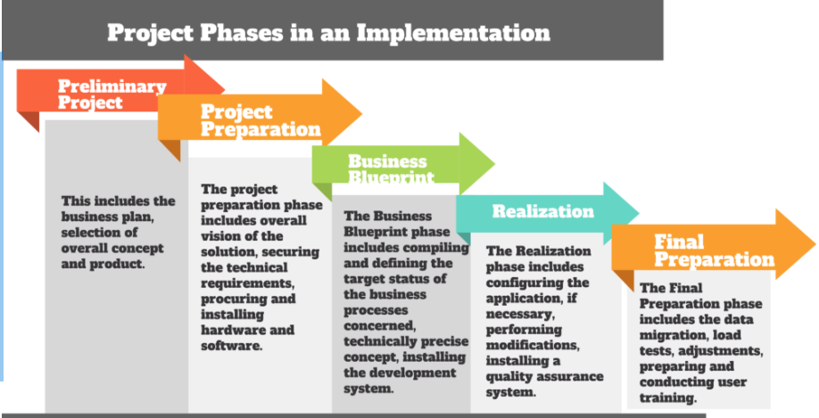
project implementation stage

Slide 36
project implementation stage
Project implementation that relies on strategic planning outlined earlier in the process can help a team achieve the project objectives while staying within budget and meeting relevant deadlines. Implementation is the part of the project cycle that bridges the planning process and the project outcomes. This step of the process, and how well it's executed, can ultimately determine the success of a project.
1. Assess the project plan
In the first phase of the project cycle, it's beneficial to establish a plan that meets the expectations of management, clients and key stakeholders. Before implementing a project, assess the plan and make sure that everyone on the team understands the project deliverables. The project manager may want to hold an initial meeting to outline everyone's assigned roles and the expected timeline, as well as any project milestones that a team works toward in the implementation phase. This initial step can help to unite the project team and set a collaborative standard for work.
2. Execute the plan
With a plan in place and expectations set for the team, it's time to start work on the project. During this step, project managers want to have regular discussions with the team about their progress. Measure the project's timeline against the projected schedule and monitor resources to ensure the team has what they need to complete the project successfully. Communication is instrumental during this part of the process to keep the team aware of the project's priorities. It's also important to provide regular progress updates to the clients or key stakeholders to remain transparent about the progress during this step.

Slide 37
project implementation stage
3. Make changes as needed
During any type of project, it's likely that a project manager needs to make changes during implementation, such as to address additional requests from the client or to keep the project within its scope. Make these adjustments as necessary, relying on the project plan to identify solutions. Continue to communicate with the team, asking questions to determine areas where they need more support. Be prepared to allocate more staff or resources if a project deviates from the plan. Change is a reality for many projects and how effectively a project manager implements those changes can affect the project's outcome.
4. Analyze project data
Throughout the implementation phase of a project, it's important to analyze data consistently to measure how a project is progressing against the initial projections. You can use specific project management software or a manual system to compile data related to staffing, resources and budget. Examine the data and determine if there are other areas where it would be beneficial to implement additional changes to help a team meet the initial project expectations. If so, go back to the previous step and make those changes, continuing to gather additional data to assess the project variables.
5. Gather feedback
Once the team has completed the project deliverables, there are still some essential steps left in the process. Gather feedback from the project team, clients and stakeholders about the project's outcome, assessing what parts of the project went according to plan and what areas the team could improve in the future. You can have direct conversations with those involved in the project to get this feedback, or you may find it helpful to send out a short survey asking for input. This step can help companies make continual improvements to ensure the successful completion of future projects.

Slide 38
project implementation stage
6. Provide final reports
In the last part of the implementation phase, provide reports to the project team, clients and stakeholders outlining how the project performed against the projected budget and timeline. Explain any areas where you needed to make changes to keep the project within its scope and budget. These reports include the applicable data related to the project's budget, time and resources. This step gives companies the chance to reflect on the successes of the project and identify any improvements needed for the future, which can have long-term benefits for the project management cycle.

Slide 39
Project Rating Index
When a firm evaluates a large number of project ideas, it may be helpful to streamline the process of preliminary screening. For this purpose, a preliminary evaluation may be translated into a Project Rating Index.

Slide 40
Project Rating Index (Steps)
Identify factors relevant for project rating.
Assign weights to these factors. (Subject to their relative importance)
Rate the project proposal on various factors, using a suitable rating scale. (5 point scale)
For each factor, multiply the factor rating with the factor weight to get the factor score
Add all the factors scores to get the overall project rating index

Slide 41
Comparative Rating of Product ideas,
PRESENT MARKET, MARKET GROWTH POTENTIAL, COSTS, RISKS
Comparative Rating of Product Ideas After elimination of unattractive venture ideas, it is desirable to choose the best of those remaining for further analysis. Various comparative schemes have been proposed for rating venture ideas. In this section factors that should be considered and some possible ranking methods are examined.
For a product idea to lead to a successful venture, it must meet the following four requirements:
An adequate present market
Market growth potential
Competitive costs of production and distribution
4. Low risk in factors related to demand, price, and costs

Slide 42
Comparative Rating of Product ideas,
Present Market The size of the presently available market must provide the prospect of immediate sales volume to support the operation. Sales estimates should not be based solely on an estimate of the number of potential customers and their expected individual capacity to consume. Some factors that affect sales are:
Market size (number of potential customers)
Product's relation to need
Quality-price relationship compared to competitive products
Availability of sales and distribution systems and sales efforts required
Export possibilities

Slide 43
Comparative Rating of Product ideas,
2. Market Growth Potential: There should be a prospect for rapid growth and high return on invested capital. Some indicators are:
Projected increase in need and number of potential customers
Increase in customer acceptance
Product newness
Social, political and economic trends (favorable for increasing consumption)

Slide 44
Comparative Rating of Product ideas,
3. Costs (Competitive costs of production and distribution): The costs of production factors and distribution must permit an acceptable profit when the product is priced competitively.
The comparative rating process should consider factor likely to result in costs higher than those of competitive producers should:
Costs of raw material inputs
Labor costs • Selling and distribution costs
Efficiency of production processes
Patents and licenses

Slide 45
Comparative Rating of Product ideas,
4. Risks: Obviously it is impossible to look into the future with certainty, and the willingness to assume risk is the major characteristic that sets the entrepreneur apart. However, unnecessary risk is foolhardy and, while it may be difficult or impossible to predict the future, one can examine, with considerable confidence, the possible effect of unfavorable future events on each of venture ideas.

Slide 46
Comparative Rating of Product ideas,
The following factors should be considered.
Market stability in economic cycles
Technological risks
Import competition
Size and power of competitors
Quality and reliability risks (unproven design)
Initial investment cost
Predictability of demand
Vulnerability of inputs (supply and price)
Legislation and controls • Time required to show profit
Inventory requirements For purposes of preliminary screening, these factors can be subjectively evaluated.

Slide 47
PROJECT SCREENING AND PROJECT SELECTION
1. Benefit Measurement Methods
The benefit measurement methods are the more popular project selection methods based on the present value of estimated cash inflow and outflow. Here, you calculate and compare the costs and benefits of all potential projects.
The following are examples of benefits measurement methods:
Benefit/Cost Ratio
Economic Value Added
Scoring Model
Payback Period
Net Present Value
Internal Rate of Return
Opportunity Cost

Slide 48
PROJECT SCREENING AND PROJECT SELECTION
Benefit-Cost Ratio (BCR): Many experts call this technique the cost-benefit ratio. It is the ratio between the present value of inflow (cost invested in the project) and the present value of outflow (value of return from the project). You should choose the project with a higher BCR.
Economic Value Added (EVA): EVA is a performance metric calculating the value created for the organization. It defines the Return on Capital (ROC) and is the net profit after deducting all taxes and capital expenditures.
You should choose the project with the higher EVA if you have several projects. Please note that the economic value added is expressed in dollars, not as a percentage.
This technique is also known as the economic model.
Scoring Model: Here, the project selection committee will list a few relevant criteria and consider them in terms of importance. Afterward, they will assign marks for these criteria. Finally, the committee will count the marks and get a final score.
The project with the highest score is selected.

Slide 49
PROJECT SCREENING AND PROJECT SELECTION
Payback Period: This is the time required to recover the cost invested in the project. If other parameters are equal, you will select the project with a minimal payback period.
Net Present Value (NPV): This is the difference between the current value of cash inflow and the current value of the cash outflow of the project. NPV should always be positive, and the project with the highest value is the better option.
Internal Rate of Return (IRR): This is the interest rate at which the net present value becomes zero. In other words, it is the rate at which the present value of the outflow is equal to the present value of inflow. You should choose the project with the highest IRR.
Opportunity Cost: This is what you lose by choosing another project. You should choose the project with the lower opportunity cost if you have several options to choose from.

Slide 50
PROJECT SCREENING AND PROJECT SELECTION
Constraints Optimization Methods
This is also known as the mathematical selection model and is used for large projects requiring complex calculations.
The following are a few constraints optimization techniques:
Linear Programming
Non-linear Programming
Integer Programming
Dynamic Programming

Slide 51
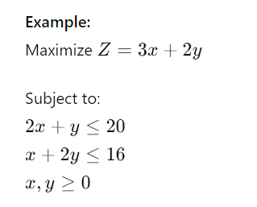
PROJECT SCREENING AND PROJECT SELECTION
1. Linear Programming (LP)
Definition: Linear Programming is a mathematical method for determining the best outcome in a model whose requirements are represented by linear relationships.
Key Characteristics:
Objective Function: A linear function that needs to be maximized or minimized (e.g., profit, cost).
Constraints: Linear inequalities or equalities that restrict the values of the decision variables.
Decision Variables: Variables that influence the outcome of the objective function.
Applications:
Resource allocation (e.g., production scheduling).
Transportation and logistics optimization.
Portfolio optimization in finance.

Slide 52
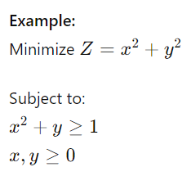
PROJECT SCREENING AND PROJECT SELECTION
2. Non-linear Programming (NLP)
Definition: Non-linear Programming involves optimizing an objective function subject to non-linear constraints. It is used when relationships between variables are not linear.
Key Characteristics:
Objective Function: A non-linear function that needs to be maximized or minimized.
Constraints: Non-linear inequalities or equalities.
Decision Variables: Variables that can take on continuous values.
Applications:
Complex engineering design.
Economic modeling.
Machine learning model optimization.

Slide 53
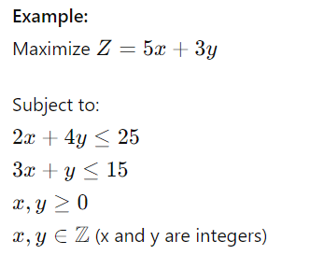
PROJECT SCREENING AND PROJECT SELECTION
3. Integer Programming (IP)
Definition: Integer Programming is a type of linear programming where some or all of the decision variables are required to be integers.
Key Characteristics:
Objective Function: A linear function.
Constraints: Linear inequalities or equalities.
Decision Variables: Variables that must take integer values.
Applications:
Capital budgeting.
Facility location planning.
Scheduling problems.

Slide 54
PROJECT SCREENING AND PROJECT SELECTION
4. Dynamic Programming (DP)
Definition: Dynamic Programming is a method used to solve complex problems by breaking them down into simpler subproblems. It is particularly useful for problems with overlapping subproblems and optimal substructure properties.
Key Characteristics:
Breaks down a problem into simpler subproblems.
Solves each subproblem once and stores the solution.
Uses the stored solutions to construct an optimal solution for the original problem.
Applications:
Inventory management.
Network optimization.
Shortest path problems (e.g., Dijkstra's algorithm).
Example: Finding the shortest path in a graph:
Use dynamic programming to keep track of the shortest paths from the starting node to each other node.
Update the paths iteratively based on the shortest paths found so far.

Slide 55
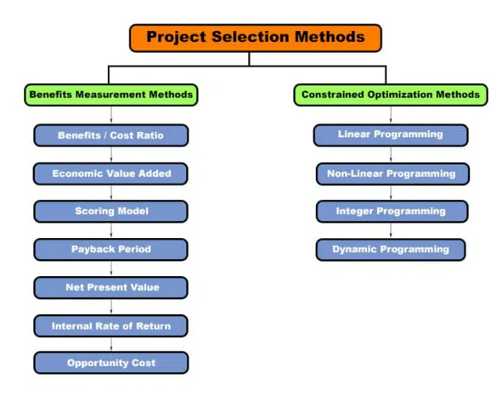
PROJECT SCREENING AND PROJECT SELECTION
Project screening and selection involve evaluating potential projects to determine which ones align best with an organization’s goals and resources.

Slide 56
Project Risk & Uncertainty
A risk is defined as “an uncertain event or condition that, if it occurs, has a positive or negative effect on a project's objectives” (PMI, 2004). It must be emphasized that a risk is characterized by having both a consequence and a probability.
An uncertainty is defined as “the difference between the amount of information required to perform the task and the amount of information already possessed by the organization” (Galbraith, 1977).

Slide 57
Types of Risks
To relate the risk categories to the levels of project objectives, the three categories are defined.
Operational Risks
Short-term strategic Risks
Long-term strategic Risks

Slide 58
Operational Risks
Risks related to operational objectives of the project. This means risks restricted to the direct results from the project—that is, its products.

Slide 59
Short-term strategic Risks
Short-term strategic risks are risks related to the objectives for project owner's use of the project results after the project has been completed.
It may also mean the risk for first-order effects of the project—that is, risk for the effects that should be achieved for the target group or users.

Slide 60
Long-term strategic Risks
Risks related to long-term strategic objectives of the project—in other words, risks related to the project purpose, or, the long-term objective that the project is meant to contribute to.

Slide 61
Criteria to Categories Risk
Operational criteria, used to evaluate whether a given risk element is long-term strategic, short-term strategic, or operational include the following:
The risk element is considered an operational risk when: the risk element is a risk to the project output (which should be specified in a project definition/delivery contract)—i.e., a risk to the project's ability to deliver.

Slide 62
Criteria to Categories Risk contd…
The risk element is a short-term strategic risk when: the risk element is a risk to a functionality not clearly specified in project definition/delivery contract, but is necessary in order to achieve the effects of the project (restricted to the first-order effects for the target group/users).
The risk element is a long-term strategic risk when: the risk element is a risk to achieving the long-term objectives of the project, but not a risk of the two categories mentioned above (i.e., operational or short-term strategic risk).

Slide 63
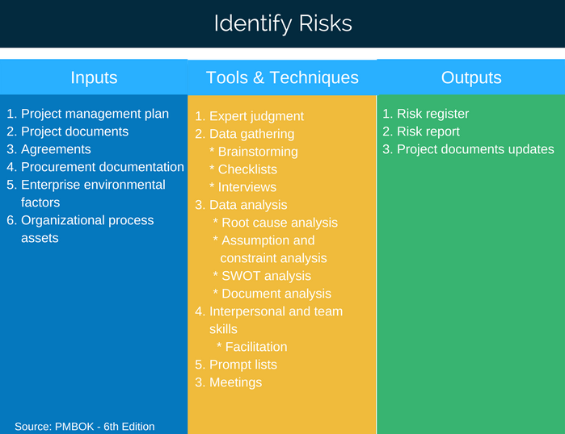
Risk Identification & Analysis

Slide 64
Risk Identification & Analysis
The risk identification function should not be left to chance but should be explicitly covered in a number of project documents:
Statement of work (SOW),
Work breakdown structure (WBS),
Budget,
Schedule,
Acquisition plan, and
Execution plan.

Slide 65
Risk Identification & Analysis
The full project team should be actively involved.
Potential risks should be identified by all members of the project team.
No criticism of any suggestion is permitted.
Any potential risk identified by anyone should be recorded, regardless of whether other members of the group consider it to be significant.
All potential risks identified by brainstorming should be documented and followed up by the integrated project team.

Slide 66
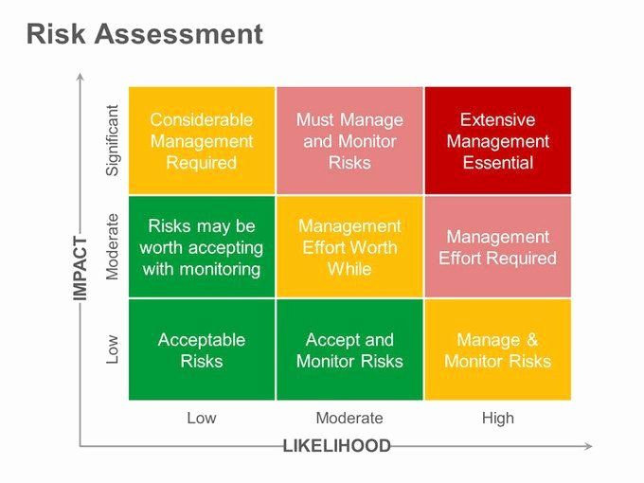
Risk Assessment

Slide 67
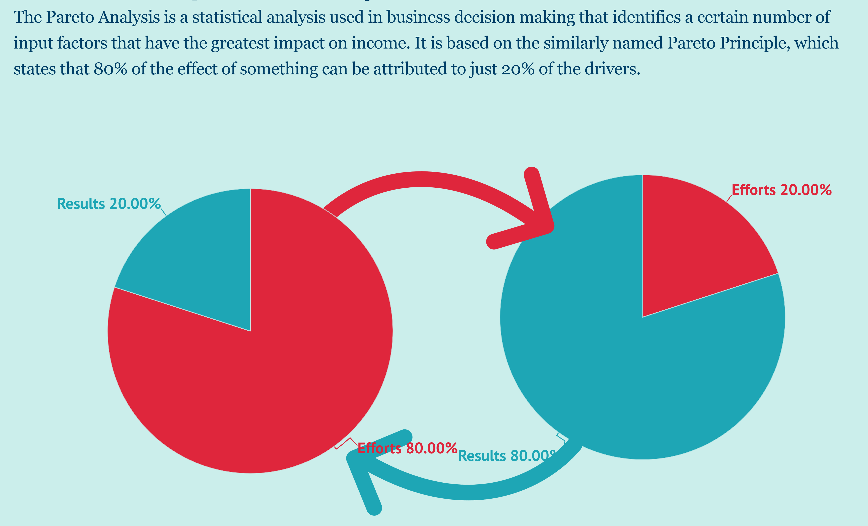
Pareto Diagrams

Slide 68
Failure Modes and Effects Analysis
In project risk assessment, a failure can be any significant event that the sponsor does not want to happen—a budget overrun, a schedule overrun, or a failure to meet scope, quality, or mission performance objectives.
The objective of failure modes and effects analysis is the identification of root or common causes, which may affect the project as a whole.

Slide 69
Project Definition Rating Index
It includes detailed descriptions of issues and a weighted checklist of project scope definition elements to jog the memory of project team participants.
It provides the means to assess risk at various stages during the front-end project planning process and to focus efforts on high-risk areas that need additional definition.

Slide 70
Quantitative Risk Analysis
Multivariate Statistical Models:
These methods are objective in that they do not rely on subjective probability distributions elicited from (possibly biased) project advocates.
Analysts build linear or nonlinear statistical models based on data from multiple past projects and then compare the project in question to the models.

Slide 71
Quantitative Risk Analysis
Event Trees:
The results of the evaluations are the probabilities of various outcomes from given faults or failures.
Each event tree shows a particular event at the top and the conditions causing that event, leading to the determination of the likelihood of these events.
These methods can be adapted to project cost, schedule, and performance risk assessments.

Slide 72
Quantitative Risk Analysis
Sensitivity Analysis:
A sensitivity coefficient is a derivative: the change in some outcome with respect to a change in some input.
Even if the probability of a particular risk cannot be determined precisely, sensitivity analysis can be used to determine which variables have the greatest influence on the risk.

Slide 73
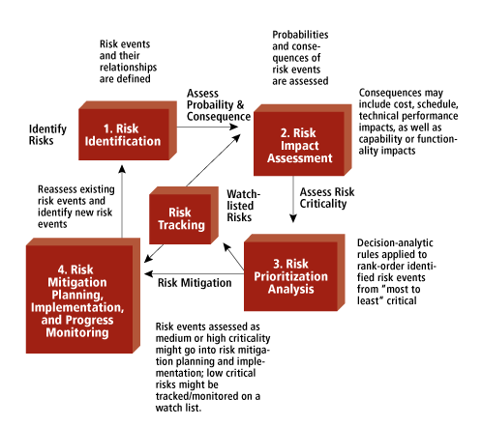
Risk Identification & Analysis

Slide 74
Risk Mitigation
1. Include risk management in your projects
2. Communicate risks to others
3. Prioritize risks
4. Analyze risks
5. Implement risk responses as early as possible
6. Track them down regularly

Slide 75
Summary
Project Identification is often the outcome of TRIGGERING PROCESSES / EVENTS rather than an analytical exercise.
To tap the creativity of the people and to harness their entrepreneurial urges, a conducive organizational climate has to be fostered.
Some kind of preliminary screening is required to eliminate ideas which prima facie are not promising

Slide 76
Daily Quiz
Discuss the project identification.
Explain the idea generation process.
Explain various sources of secondary data.
Describe the chain ratio method of demand forecasting.
Discuss the methodology of Delphi Technique.
Describe the types of risks associated in projects.
Explain various risk mitigation strategies in project management
Discuss the process of identifying the risk associated to project.

Slide 77
Weekly Assignment
Q1. Describe the identification and generation of idea in project management.
Q2. Describe the market and demand analysis techniques in reference to project management.
Q3. Describe various types of risks associated in project management.
Q4. Describe various risk mitigation strategies in project management.

Slide 78
MCQ s
Q1. ETIG stands for.
Economic times intelligence group
Economic, Technological, Implementation, Governance
Early Times investigation group
None of the above
Q2. The market survey can be a.
Census survey
Sample survey
Both A & B
None of the above

Slide 79
MCQ s
Q3. In market survey a sample of _______is contacted or observed.
Population
Sample Frame
Universe
None of the Above
Q4. Which of the following attribute of questionnaire has an impact on the results of market survey?
A. Quality
B. Adequate questions
C. Accuracy
D. All of the above

Slide 80
MCQ s
Q5. Bass Diffusion method was developed by.
Frank Bass
Huses Bass
Pascal
Devorak
Q6. Leading indicator are the variables which change ______of the other variables.
Ahead
After
Simultaneously
None of these

Slide 81
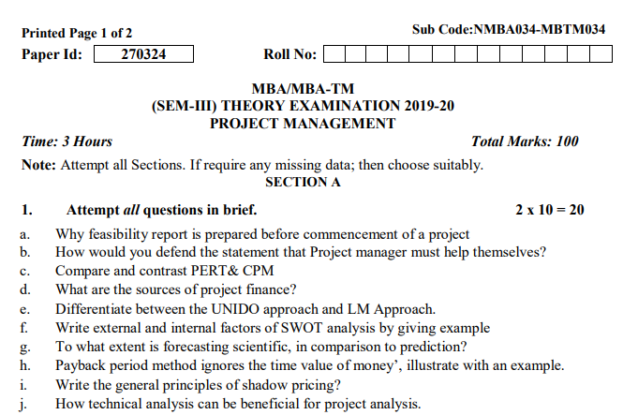
Old Question Papers

Slide 82
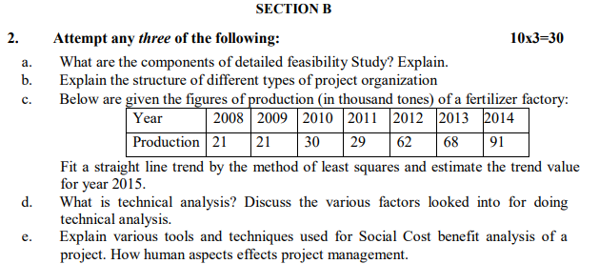
Old Question Papers

Slide 83
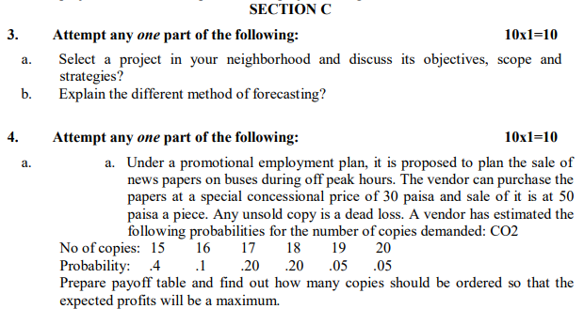
Old Question Papers

Slide 84
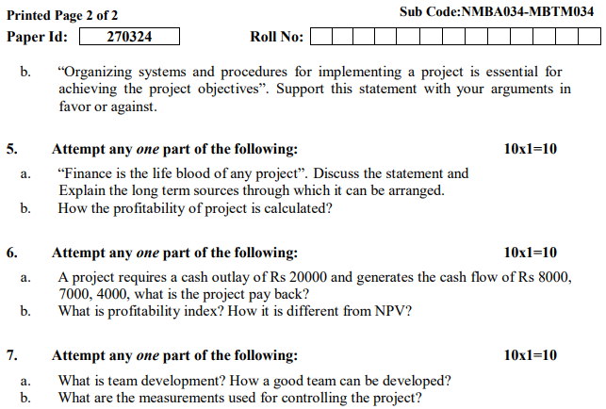
Old Question Papers

Slide 85
Expected Questions for University Exam
Q1. Describe the situational analysis.
Q2. Discuss the demand analysis. Explain various demand forecasting techniques used in demand analysis.
Q3. Explain the project risk. Discuss various categories of the project risks.
Q4. Explain various risk mitigation strategies which are used in project risk management.

Slide 86
Summary
Market & Demand analysis is concerned with two broad issues:
What is the likely aggregate demand for the product?
What share of the market will the proposed project enjoy?
A risk is defined as “an uncertain event or condition that, if it occurs, has a positive or negative effect on a project's objectives”
The project idea must be compatible with the interest, personality & resources of an entrepreneur

Slide 87
References
https://www.google.com/search?q=swot+analysis&source=lnms&tbm=isch&sa=X&ved=2ahUKEwilkNT1o4HqAhXmyDgGHfoJDQYQ_AUoAXoECBUQAw&biw=1366&bih=625#imgrc=7Amj-sb0Om2yaM
https://www.google.com/search?q=project+rating+index&source=lnms&tbm=isch&sa=X&ved=2ahUKEwjV9dPGsoHqAhUCgUsFHdpeDq4Q_AUoAXoECA4QAw&biw=1366&bih=625#imgrc=tTpMwtglZHlEpM
https://www.managementstudyguide.com/what-is-project-risk.htm
https://www.pmi.org/learning/library/categorizing-risks-project-risk-management-6847
https://projectriskcoach.com/identify-project-risks/
https://www.nap.edu/read/11183/chapter/6#37
https://www.youtube.com/watch?v=dAJy-3A6lPM
https://www.youtube.com/watch?v=4Or352bDQd4
https://www.youtube.com/watch?v=a0pAWPrKiGk
https://www.youtube.com/watch?v=RbCQH6AoEeE

Slide 88
References
Books:
Larsen, E.W., Gray C.F., & Joshi, R. (2021). Project management: The Managerial process. McGraw Hill.
Chandra, P. (2019). Projects: Planning, Analysis, Selection, Financing, Implementation and Review. McGraw Hill.
REFERENCE BOOK:
Nagarajan, K. (2017). Project Management. New Age International Pvt. Ltd.
Paneerselvam, R., & Senthilkumar, P. (2013). Project Management. Prentice Hall India Learning Pvt. Ltd.
Pinto, J.K. (2020). Project Management. Global EduTech.
Desai, V. (2016). Project Management. Himalaya Publishing House.

Slide 89


Thank You

